Slide 1
A Level English Literature
Course Outline at Mountain Ash Comprehensive School

Slide 2

Why study English Literature?
By choosing to study A Level English Literature, you will develop your communication, writing and literary knowledge. You will do this by searching for patterns and information which will help you to understand complex ideas about human attitudes and behaviour.
Furthermore, the skills learnt throughout the course are relevant to variety of roles such as advertising, marketing, journalism, being an author, law, teaching, performing arts and many more! It is also necessary for careers in the sciences, engineering, technology and maths as you will need to write proposals, academic papers and articles!

Slide 3
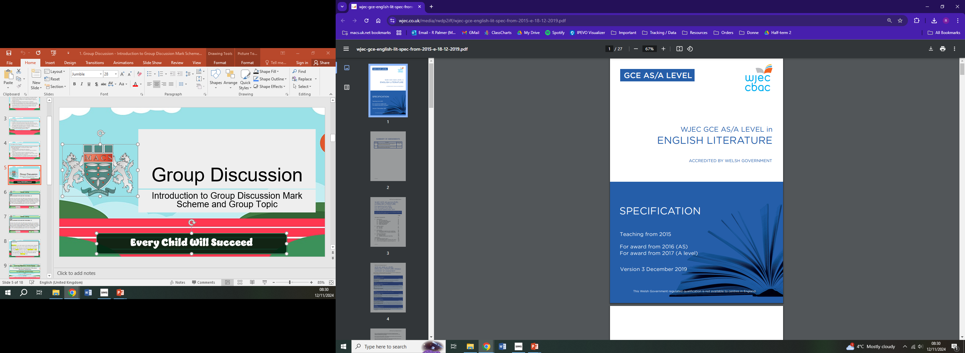
What are the aims of GCSE English Literature course?
The course aims to enable learners to:
read widely and independently
engage critically and creatively with a texts and ways of responding to them
develop and effectively apply their knowledge of literary analysis and evaluation
explore the contexts of the texts they are reading and others’ interpretations of them
undertake independent and sustained studies to deepen their appreciation and understanding of English literature, including its changing traditions.

Slide 4
How will you learn throughout Year 12 and 13?
You will have the opportunity to learn from two experienced English teachers (Director of Learning English and Deputy Director of Learning English) who will be able to support and guide you to achieve the best grades possible.
The course builds on your knowledge, understanding and skills established at GCSE. It will provide opportunities for you to consider individual, moral, ethical, social, cultural and contemporary issues through the study of literary genres such as poetry, prose and drama.
As you progress through the two-year course, your learning will be extended in breadth and depth, developing and enhancing techniques of analysis, evaluation and comparison of literary texts in the context of a wider range of texts of cultural and literary significance.
The course will extend your ability to analyse, evaluate and make connections which are essential for further study of English Literature or other related areas.

Slide 5
AS Unit – Year 12
Unit 1: Prose and Drama | 2 hours | 20%
Section A: Prose Fiction Pre-1900 – ‘Jane Eyre’ by Charlotte Bronte This section requires you to answer one extract question and one linked essay question based on ‘Jane Eyre’. You will need to comment fluently, accurately and effectively on your understanding of the text. You will draw on your understanding of different interpretations and use accurate evidence to support your comments.
Section B: Drama –’Streetcar Named Desire’ by Tennessee Williams This section requires you to answer one essay question from a choice of two based on ‘A Streetcar Named Desire’. You will need analyse the text in a variety of ways and considers how attitudes and values are expressed.

Slide 6
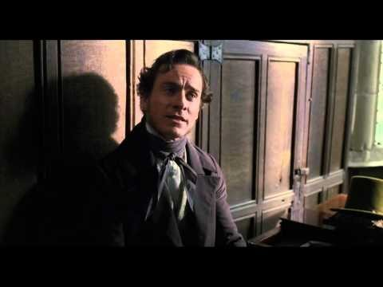
‘Jane Eyre’, Charlotte Bronte

Slide 7

‘A Streetcar Named Desire’, Tennessee Williams

Slide 8
AS Unit – Year 12
Unit 2: Poetry Post 1900 – Ted Hughes and Sylvia Plath | 2 hours | 20%
Section A: Critical Analysis This section requires the critical analysis of one poem by either Ted Hughes or Sylvia Plath. You will need to analyse how meanings are shaped in poetry and the ways writers adapt structure, form and language in poetry for effect.
Section B: Poetry Comparison This section requires you to answer one question comparing one poem by Ted Hughes and one poem by Sylvia Plath. You will need to show understanding of how the poems relate to one another and draw on your understanding of different interpretations.

Slide 9
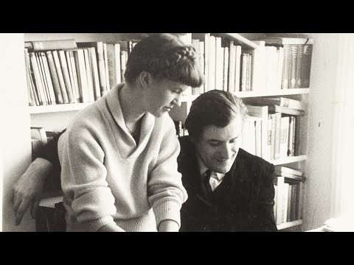
Ted Hughes and Sylvia Plath

Slide 10
A2 Unit – Year 13
Unit 3: Poetry Pre-1900 and Unseen Poetry | 2 hours | 20%
Section A: Poetry Pre-1900 – John Donne This section requires you to critically analyse one poem and answer one linked essay question on John Donne. You will need to analyse how meanings are shaped in poetry and the ways writers adapt structure, form and language in poetry for effect.
Section B: Unseen Poetry This section requires you to answer one question comparing two unseen poems. It gives you an opportunity to reflect on the knowledge that you’ve gained from the course and apply your literary analysis skills to the examine two poems that are new to you.

Slide 11
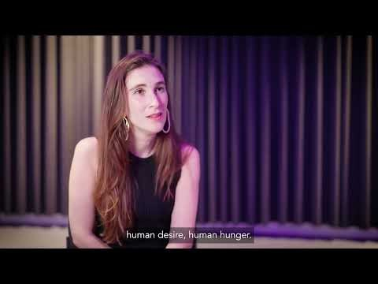
John Donne

Slide 12
A2 Unit – Year 13
Unit 4: Shakespeare – ‘Hamlet’ | 2 hours | 20%
Section A: Shakespeare Extract This section requires you to answer one extract question from ‘Hamlet’. You will need to use a range of literary concepts and terminology to organise your response in a clear and effective academic style.
Section B: Shakespeare Essay This section requires you to answer one essay question from a choice of two on ‘Hamlet’. You will need to show understanding of the cultural and contextual influences of the time and reflect on different interpretations.

Slide 13
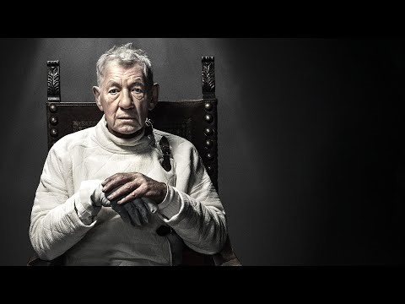
‘Hamlet’

Slide 14
A2 Unit – Year 13
Unit 5: Prose Study | Coursework | 20%
Section A This unit is internally assessed and externally moderated. It is an opportunity to write an assessment based on the reading of two texts of your choice by different authors, one published pre-2000 and the other published post-2000. You will need to read texts in a variety of ways, communicate fluently, explore comparisons, consider how attitudes expressed and use accurate quotations.

Slide 15
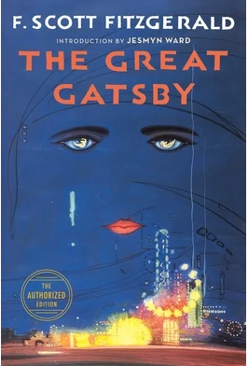
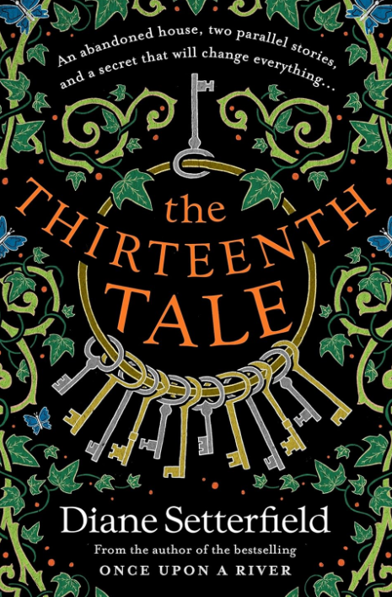
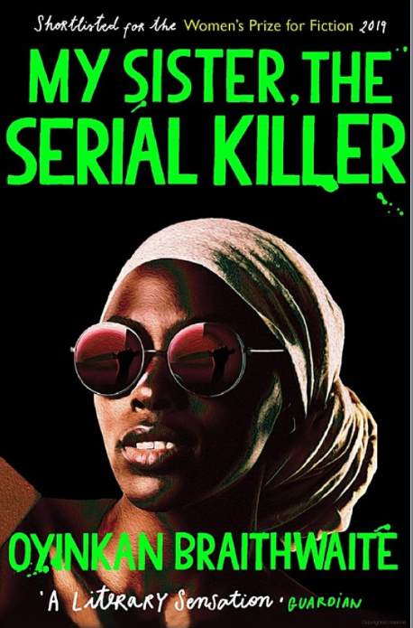
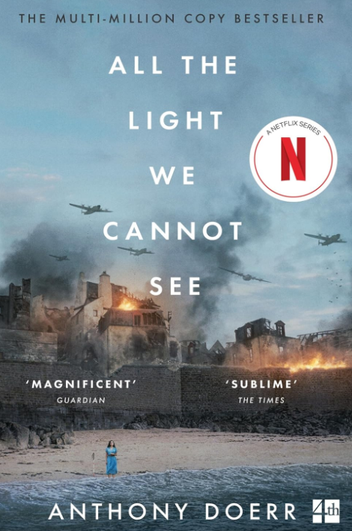
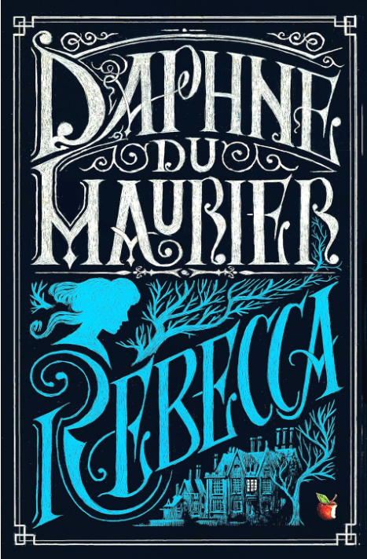
Potential Texts You Could Study…
…and many more!

Slide 16

If you have any questions, then please come along to the Open Evening at Aberdare Community School on 19 November and we will be happy to help you!
If you’re not able to make this then please feel free to email Mrs Palmer (Director of Learning English) rhiannon.palmer@macs.uk.net with any queries you have.

